Slide 1
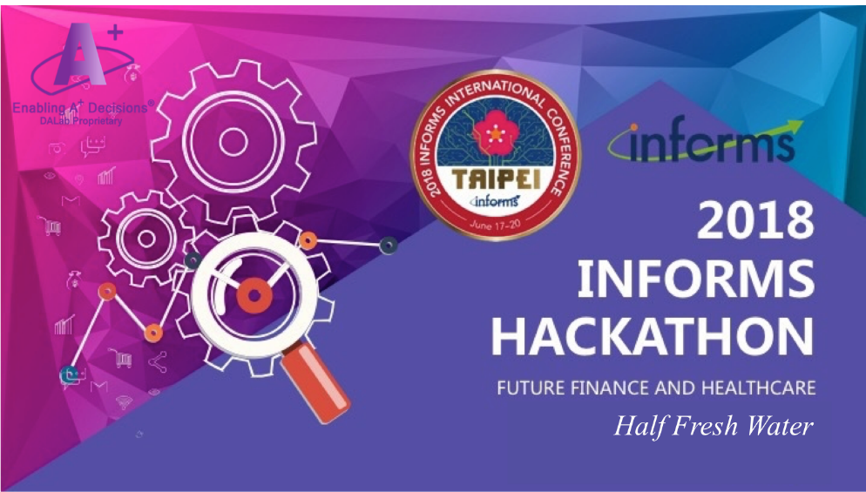
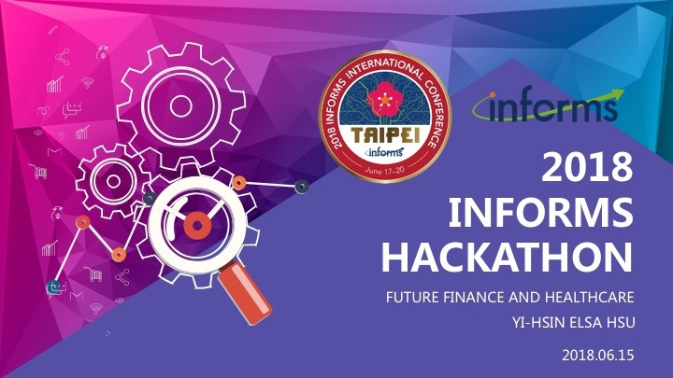

Slide 2
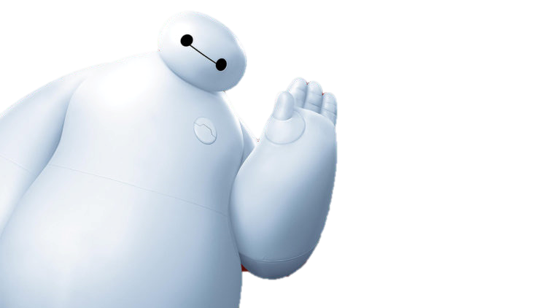
Baymax
is not a Dream

Slide 3
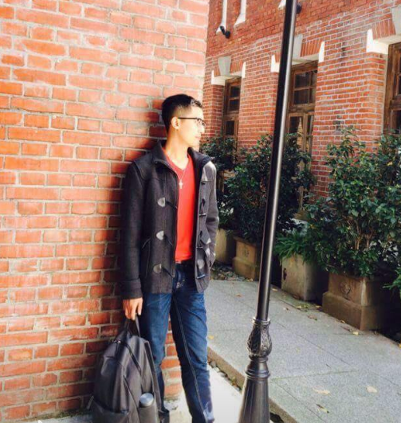
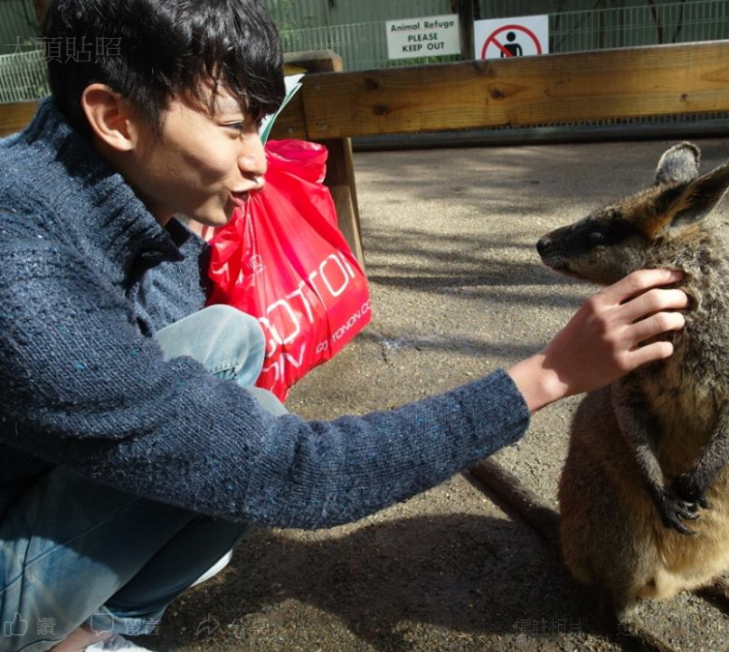
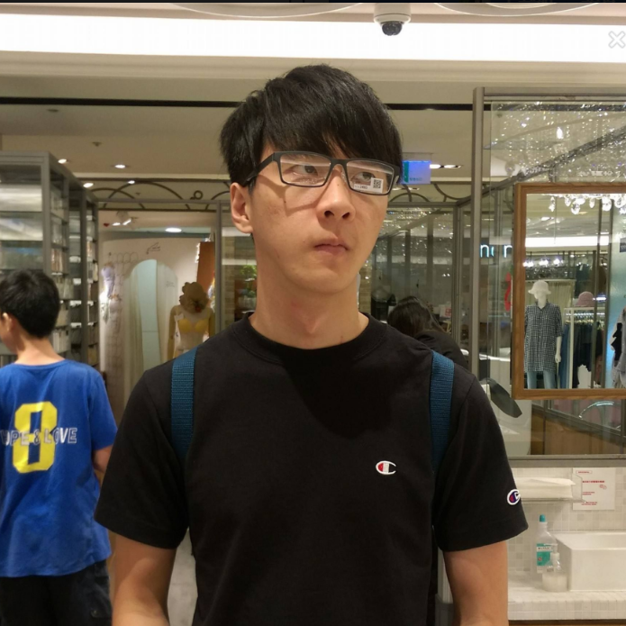
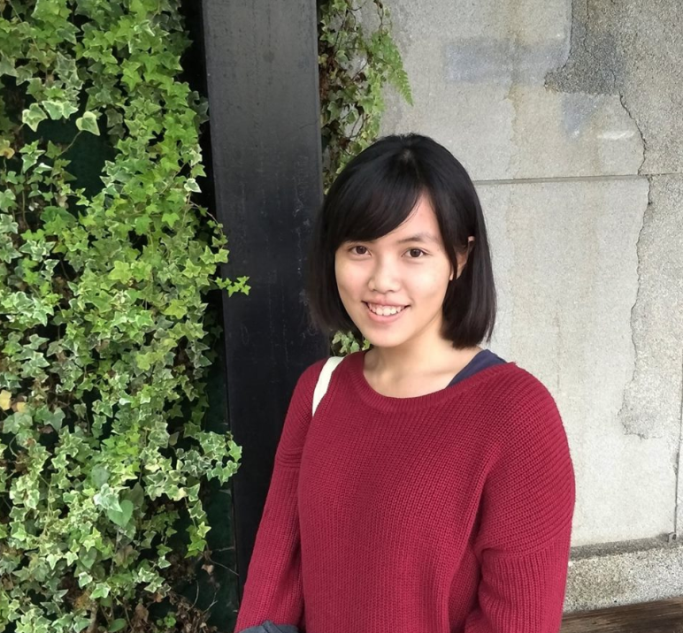
HalfFreshWater
Lin, Sheng-Kai
Lee, Chi-Ming
Chen, Chi-Hang
Ting, Wei-Ju

Slide 4
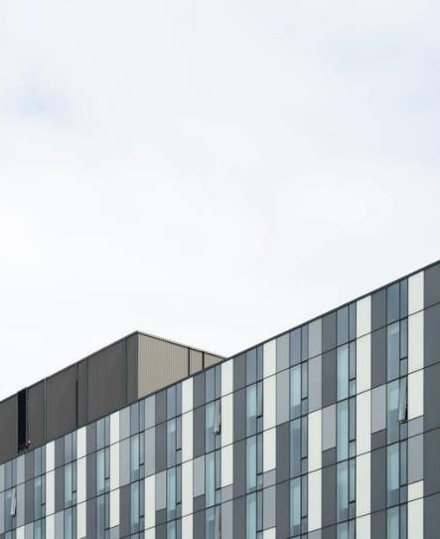
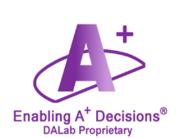
ABOUT US
HalfFreshWater means we encourage ourselves to keep learning something new and try our best to do the thing we think we cannot do.
1
Use AI technology to help our daily life.
2
Putting what we've learned into practice.
3
Industry 3.5

Slide 5

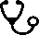
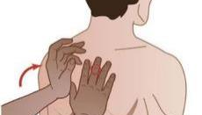
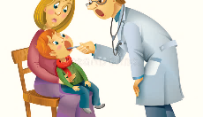
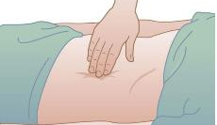
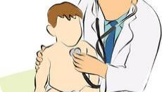


Physical Assessment
Inspection
Auscultation
Inspect each body system using
vision to assess normal conditions and deviations. Assess for color,
size, location, movement as you
assess each body system.
Auscultation involves listening for various lung, heart, and bowel sounds with a stethoscope.
Percussion
Palpation
Percussion involves tapping your fingers or hands quickly and sharply against parts of the patient's body to help you locate organ borders.
Palpation requires you to touch the patient with different parts of your hands, using varying degrees of pressure.

Slide 6

Motivation
Medical Accessibility
01
Offer full accessibility to fast screening for everyone and suggest whether further diagnosis is needed.
Early Detection & Diagnosis
02
Early diagnosis of disease generally increases the chances for successful treatment.
Improving Efficiency
03
Fast screening will prevents people from wasting a healthcare resource.
Privacy & Data Collection
04
Use of the app feeds user data into an anonymous pool for future study.
Notes:
目標
提前診斷(預防)
資料取得不易 蒐集資料 (隱私)
降低醫療門檻(易用性、快篩)
減少醫療資源浪費

Slide 7

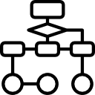



AI Techniques
Inception-ResNet-v2
Transfer Learning
Class Activation Mapping
Inception-ResNet-v2 is a variation of Inception V3 model combined with ResNet.
Transfer Learning is to reuse the pre-trained model
CAM is a simple technique to identify a specific class in the image.

Slide 8


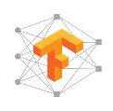
Performance
Data
299 x 299 pixels
5 hrs
training
1200
:
testing
400
50 epoch
88%
92%
Testing
Training
Tensorflow

Slide 9
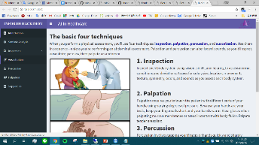
Website
Data collection
03
Check the user’s willingness to collect their data
04
Statistic analysis
Show the statistics on diseases in Taiwan
Diagnosis
01
Classify uploaded image
and show the output
Suggestion
02
Give suggestions for different conditions

Slide 10
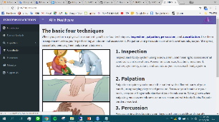
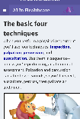
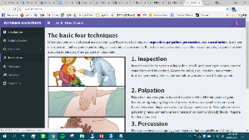
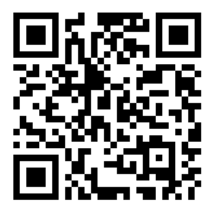
Different Devices
Laptop
Mobile
Desktop

Slide 11





Data Flow
Training
Classification
Suggestion
Training model with
the data on hand
Classify the new image with the model
Give user a suggestion for further action.
Update data
Data collection
Update the dataset after permission
Check the user’s willing to access their data and use it in the future research

Slide 12


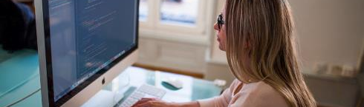
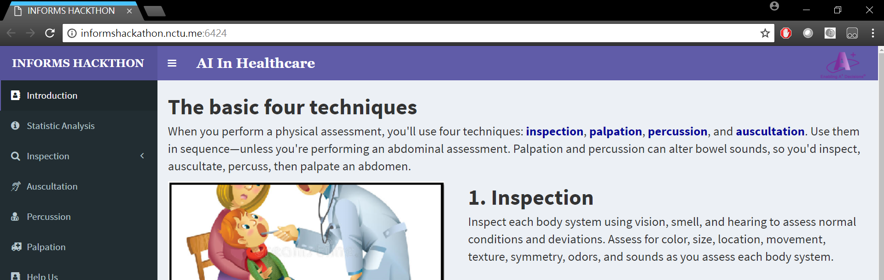
Future Work
Combined with Google Map
Personal Healthcare Robot
Spot hospitals nearby
Powerful Diagnosis
Give users real time assistance like Baymax
Diagnosis more diseases and increase the accuracy

Slide 13
THE END

